Slide 1
Acquisition and Pointing in
Free Space Optical Communication
PRESENTED BY:
SHAM GANESH V (2022504023)
MADHAN K (2022504531)
LOKESHWARAN R (2022504057)

Slide 2
CONTENTS
What is Acquisition, Tracking, and Pointing (ATP)?
The Acquisition Process: Establishing the Link
Understanding the "Point Ahead Angle" (PAA)
The Challenge: Acquisition Uncertainty Area
Techniques for Scanning the Uncertainty Area
Common Acquisition Approaches
Tracking and Pointing for Link Maintenance
The Integrated ATP System
Conclusion

Slide 3
What is Acquisition, Tracking, and Pointing (ATP)?
Acquisition: The crucial first step of searching for and locating the receiving terminal to establish an initial optical link.
Tracking: The process of continuously maintaining the established line-of-sight connection, compensating for any movement of the terminals or atmospheric disturbances.
Pointing: The act of precisely aiming the narrow laser beam at the receiver's detector.
Why is ATP so critical in FSO?
FSO systems use highly directional, narrow laser beams.
Even minor pointing errors can cause a significant loss of signal or complete link failure, leading to data loss.

Slide 4
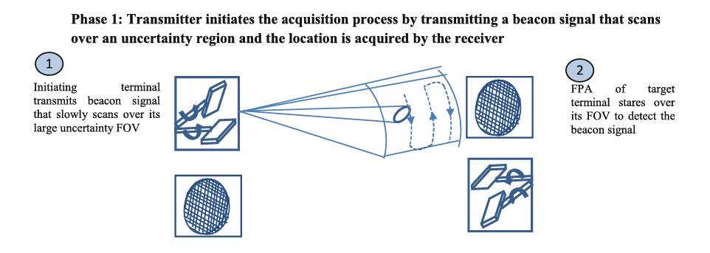
The Acquisition Process: Establishing the Link
Beacon Signal: The process begins with one terminal transmitting a wider "beacon" laser beam to scan the 'uncertainty area' where the other terminal is predicted to be.
Searching: The receiving terminal simultaneously searches for this beacon signal within its Field of View (FOV) using a Focal Pixel Array (FPA).
Locking On: Once the beacon is detected, the system locks onto the signal, narrows its field of view, and a return signal is sent to complete the link.

Slide 5
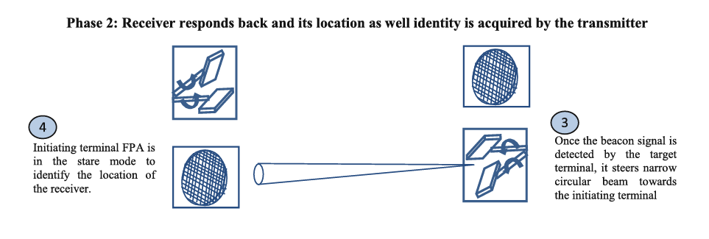
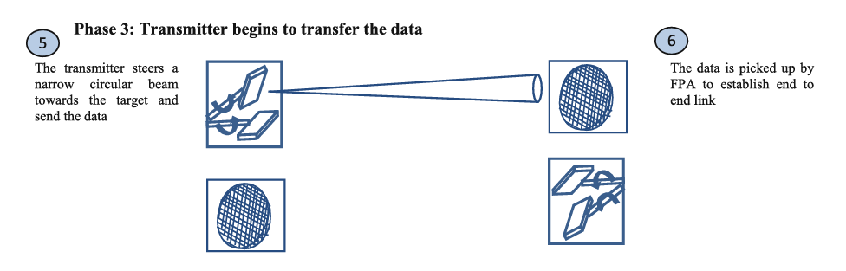
The Acquisition Process: Establishing the Link

Slide 6

Understanding the "Point Ahead Angle" (PAA)
Definition: Due to the finite speed of light and the relative motion between terminals (e.g., a ground station and a satellite), the transmitter must aim at the future position of the receiver. This angular correction is the Point Ahead Angle.
Calculation: The PAA is determined by the relative velocity of the terminals and the round-trip time of light. For a Low Earth Orbit (LEO) satellite, this can be around 50 µrad.
Implementation: The PAA is managed by internal pointing elements within the ATP system.

Slide 7
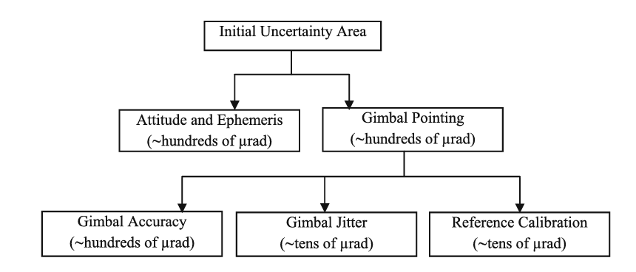
The Challenge: Acquisition Uncertainty Area
Definition: The initial uncertainty area is the region in which the target terminal is located, which must be systematically searched.
Contributors to Uncertainty: Errors in satellite's position data (ephemeris uncertainty).Errors in the satellite's orientation (attitude uncertainty).These errors are random and contribute to both azimuth and elevation uncertainties.
Impact: A large uncertainty area combined with a narrow beacon beam can lead to an unacceptably long acquisition time.
Fig4:Various contributors to the acquisition initial uncertainty area budget for ground-to satellite FSO link

Slide 8
Techniques for Scanning the Uncertainty Area
To efficiently search the uncertainty area, specific scanning patterns are used:
Spiral Scan:
  The most efficient technique where the beam scans outward in a spiral pattern from the center.
  Can be a smooth continuous spiral or a step-by-step spiral.
Raster Scan:
  The beam scans horizontally and then steps down to the next line, similar to reading a page.
  This method is generally less efficient than spiral scanning.
Segmented Scan:
  The uncertainty area is divided into sections, and the area with the highest probability of finding the target is scanned first to reduce time.

Slide 9
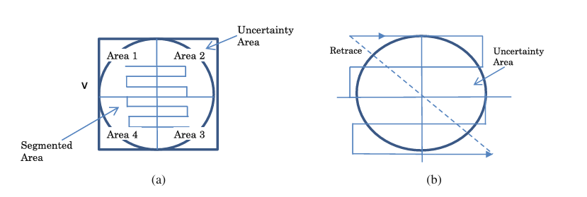
Techniques for Scanning the Uncertainty Area
Fig4:Spiral scan pattern (a), continuous spiral scan, and (b) step spiral scan

Slide 10
Common Acquisition Approaches
Stare/Scan (Most common for ground-to-satellite links):
The receiver "stares" with a wide FOV.
The transmitter "scans" the uncertainty area with a narrow, powerful beam.
Other Approaches:
Stare/Stare: Both use wide beams. Suited only for short distances due to power limitations.
Scan/Scan: Both the transmitter beam and receiver FOV are scanned simultaneously.

Slide 11
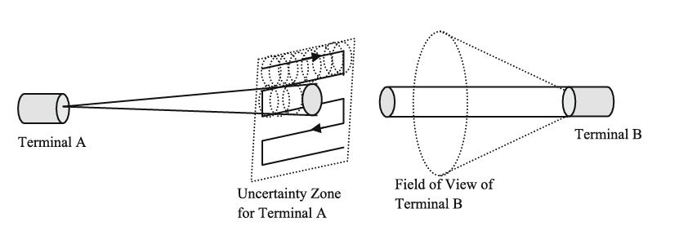
Common Acquisition Approaches
Fig5:Stare/scan acquisition technique where one terminal (Terminal A) slowly scans its transmitting signal while other terminal (Terminal B) scans through its entire uncertain region

Slide 12
Tracking and Pointing for Link Maintenance
Total Pointing Error: This is the sum of tracking errors and point-ahead errors.
Sources of Tracking Error:
Angular Jitter: Small, rapid vibrations in the tracking system.
Residual Jitter: Vibrations from larger components like gimbal systems that cannot be fully
compensated for.
Quadrant Detectors:
These are specialized detectors (like QAPD or QPIN) divided into four sections.
By comparing the amount of light hitting each quadrant, the system can determine the exact position of the beam and generate error signals to correct the pointing.

Slide 13
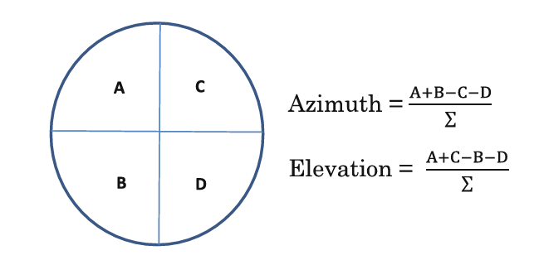
Tracking and Pointing for Link Maintenance
Fig6:Quadrant detector

Slide 14
Conclusion
Acquisition, Tracking, and Pointing are fundamental to the success of any FSO communication system, especially over long distances.
The process involves a trade-off between acquisition time, power requirements, and beam divergence.
A robust ATP system, using efficient scanning techniques and precise tracking mechanisms, is essential for establishing and maintaining a reliable, high-bandwidth optical link.

Slide 15
THANK YOU

